Slide 1

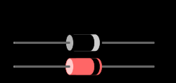
Diode

Slide 2
Introduction
A diode is an electrical device allowing current to move through it in one direction with far greater ease than in the other.

Slide 3
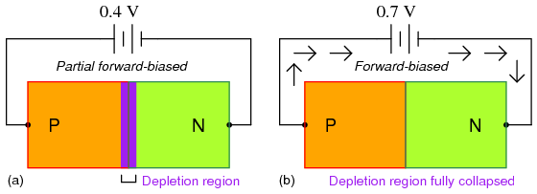
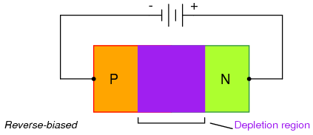
FABRICATION

Slide 4
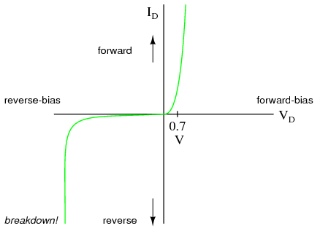
CHARACTERISTICS

Slide 5

OPERATION
When placed in a simple battery-lamp circuit, the diode will either allow or prevent current through the lamp, depending on the polarity of the applied voltage.
Diode operation: (a) Current flow is permitted; the diode is forward biased. (b) Current flow is prohibited; the diode is reversed biased

Slide 6







TYPES OF DIODES

Slide 7
Applications of diodes
Signal rectifier
Diode gate
Diode clamps
Limiter

