Slide 2
Performance characteristics
Static characteristics
Dynamic characteristics

Slide 3
Static chracteristics
Instrument
Measurement
Accuracy
Precision
Sensitivity
Resolution
Error
Expected value
Uncertainty
Threshold

Slide 4
Dynamic Characteristics
Dynamic Error
Fidelity
Speed Response
Response time
Measuring LAG

Slide 5
LOADING EFFECT
When an instrument of lower sensitivity is used with a heavier load the measurement it makes is erroneous, this effect is known as loading effect. Example - Consider a lower sensitivity (ohm per volt) voltmeter being used with a high resistance load.

Slide 6
In measurement system, when on introducing an element, used for any purpose (May be for signal sensing, conditioning, transmission or detection), into the system, the original signal remains undisturbed i.e., introduction of any element in a measurement system should not distort the original signal in any form.
However in practical conditions it has been found that when an element is introduced in a measurement system, in extracts some energy from the system and, therefore, original signal is distorted. Such distortion may take the form of attenuation, waveform distortion, phase shift and many a time all these undesirable features put together. Thus ideal measurement is not practical. The incapability of the system to faithfully measure, record or control the input signal (measure and) in undistorted form is known as the loading effect

Slide 7
A measurement system consists of three distinct stages that are
(i)Detector-transducer stage,
(ii)Signal conditioning stage including original transmission stage
(iii) Signal presentation stage
Loading effect not only occur at first stage but also may occur in any of the two
Subsequent stages.
In measurement system, we deal both electrical and mechanical quantities and
Elements and so the loading effect may occur on account of both electrical and
Mechanical elements. The loading effects are due to impedances of various
Elements connected in a system.

Slide 8
Error in measurement
Am- Measured value
A-True value
δA (Absolute error)=Am- A
Relative error, εr = δA/A= εo /A= Absolute error/True value
When the absolute error εo= δA is negligible, when the difference between measured value Am and true value A is negligible then relative error may be expressed
εr= δA/Am
% of error= εr * 100= (εo /A ) *100

Slide 9
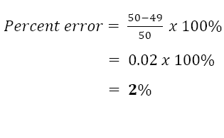
Example 1
The expected value of the voltage across a resistor is 50V; however, measurement yields a
value of 49V. Calculate
a) The absolute error
b) The percent of error
Solution
Yn-Expected value, Xn-Measured value
a) e = Yn – Xn
= 50V – 49V
= 1V
b)

Slide 10
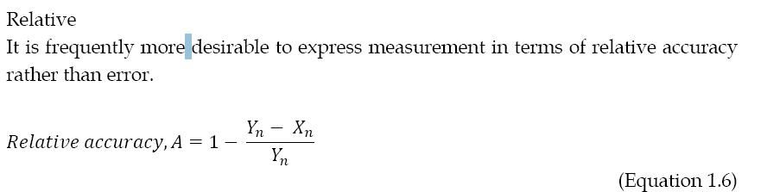

Slide 11
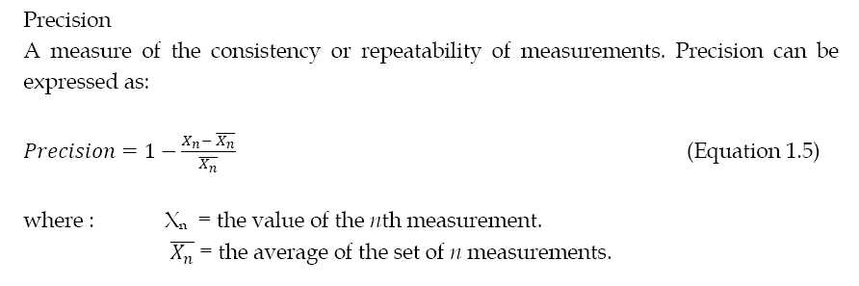
Accuracy
Percent accuracy, a = 100% - percentage of error
= A X 100%

Slide 12
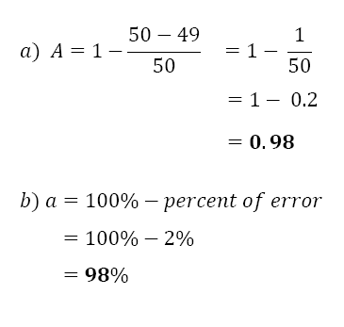
The expected value of the voltage across a resistor is 50V; however, measurement yields a
value of 49V. Calculate
a) The relative accuracy
b) The percent of accuracy

Slide 13
TYPE OF ERROR
Errors are generally categorized under the following three
major types
Gross error
This class of errors is generally the fault of the person using the instruments such as
incorrect reading of instruments, incorrect recording of experimental data or data
incorrect use of instruments.
As long as human beings are involved, some gross errors will definitely
commit. Although complete eliminating of gross errors is probably impossible, one
should try to avoid them. The following actions may be necessary to reduce the
effects of gross errors.
a) Great care should be taken in reading and recording the data.
b) Two or more readings should be taken by different experimenters

Slide 14
Systematic error
Systematical errors can be divided into four categories:
a) Instrumental Error
These errors arise due to main reasons:
i. Due to inherit shortcoming in the instruments (may be caused by the
construction, calibration or operation of mechanical structure in the
instruments).
ii. Due to misuse of the instruments. For example, these may be caused
by failure to adjust zero of the instruments.
iii. Due to loading effect of the instruments. These errors can be
eliminated or at least reduced by using the following methods:
a) The procedure of measurements must be carefully planned.
b) Correction factors should be applied after detection of these
errors.
c) Re-calibration the instrument carefully.
d) Use the instrument intelligently.
b) Observational Errors
i. Due to the types on instrument display, whether it is analog or digital.
ii. Due to parallax (eye should be directly in line with the measurement
point).

Slide 15
c) Environmental Errors
Due to conditions external to the measuring device such as the area,
surrounding the instrument. These conditions may be caused by the changes
in pressure, humidity, dust, vibration or external magnetic or electrostatic
fields. These errors can be eliminated or reduced by using corrective measure
such as:
i. Keep the condition as constant as possible.
ii. Use instrument/equipment which is immune to these effects.
iii. Employ technique which eliminates these disturbances.
d) Simplification Errors
Due to simplification of a formula: For example: A = B + C + D2.
If D is too small, then the formula is simplified to: A = B + C.
There will be a different result between the first and the second equation. In
high accuracy requirements, a formula should not be simplified to avoid
these types of errors.

Slide 16
3. Random error
In some experiments, the results shows variation from one to another, even after all
systematical and gross errors have been accounted for. The cases of these errors are
not recognized, therefore the elimination or reduction of these errors are not possible.
When these types of errors are occurred, the best result can be determined by
statistical analysis.

Slide 17
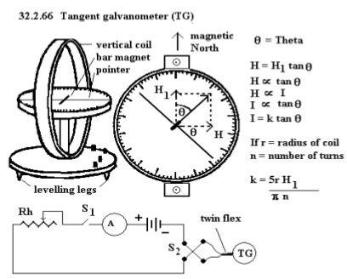
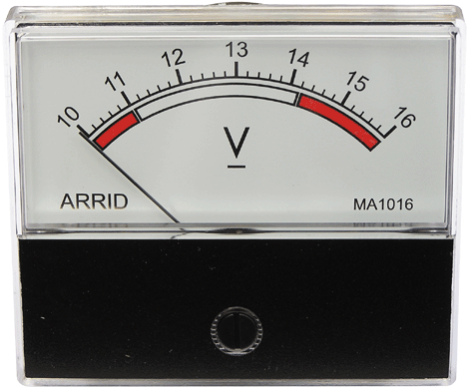
Classification of instruments
Absolute instruments
Secondary instruments
They gives the magnitude of the quantity under measurement in terms of physical constants of the instrument.
So constructed that the quantity being measured can only be measured by observing the output indicated by the instruments. These instruments are calibrated by comparison with an absolute instrument.

Slide 18
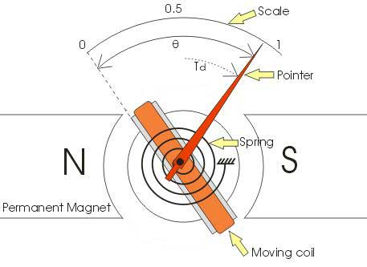
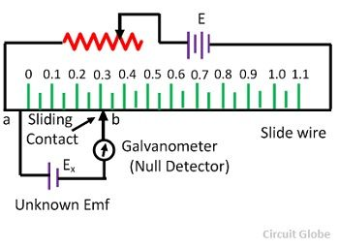
Deflection type instrument
Null type instruments
PMMC
DC potentiometer

Slide 19
Analog and Digital modes of Operation
Analog mode
Digital Mode
Signals that vary in continuous fashion and take on an infinite number of values in any given range are called analog signals.
Signals which vary in discrete steps and thus take up only finite different values in a given range are called digital signals.

Slide 20
Functions of instruments and measurement system
Indicating function
Recording function
Controlling function

Slide 21
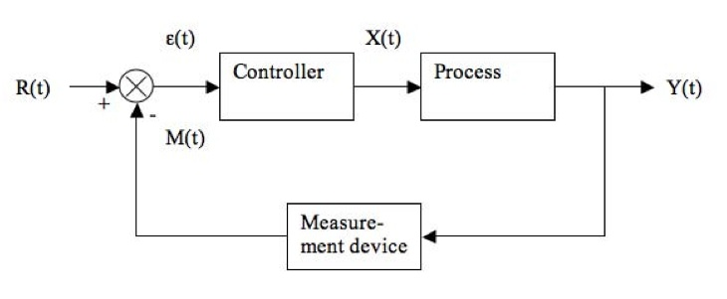
Applications of measurement systems
Monitoring of processes and operations
Control of process and operations
Experimental Engineering analysis

Slide 22
Errors in measurement
True Value
Static Error (measured value-true value)
Static Correction (true value-measured value)
Scale Range and Scale span
Error calibration curve
Reproducibility and drift
Repeatability
Noise

Slide 23
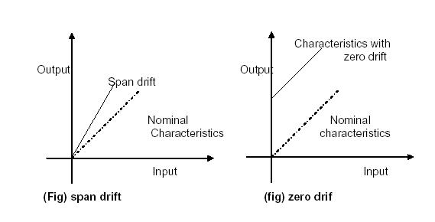
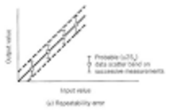

Slide 24
Noise
Extranous of current or voltage in an electrical or electronics circuit is called Noise.
What is Signal to Noise Ratio?
Types of Noises?

Slide 25
Signal to Noise Ratio
Unwanted signal superimposed upon the signal of interest and causes a deviation of output.
S/N=Signal power/Noise Power
= (Signal of interest expressed in volts)²/ (Unwanted noise expressed in volts)²

Slide 26
Sources of Noise
Generated Noise-
Conducted Noise
Radiated Noise

Slide 27
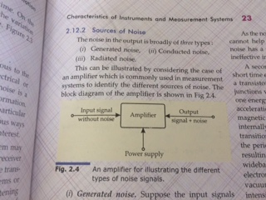
Generated Noise
Possible sources of noise are-resistor, capacitors, transistors so called generated Noise.
This vibratory motion of atoms is transferred to the conduction electrons, thereby producing a noise component of current. Since this noise is temperature dependent, it increases with internal heating (I²R loss), this is called Johnson noise.
Vibrations produced by thermal effects within a resistor cover a wide frequency range, and therefore the noise
Generated consists of a wide spectrum of
Frequencies. This wideband noise is
Sometimes called White noise.
Shot noise

Slide 28
Conducted Noise
The power supply to the amplifier could be the source of noise since it may have spikes, ripple or random deviations that are conducted to the amplifier through power wiring. This type of noise is called Conducted Noise.

Slide 29
Radiated Noise
There may be electric or magnetic field disturbance in the environments around the amplifier because of which unwanted signals are radiated into the interior of the amplifier and this is called radiated noise.

Slide 30
Johnsan noise
Derivation

