Slide 1
Robot End-Effector
Er.Rashmi
Assistant Professor
GNA University

Slide 2
End Effector
End effector is gripper or end-arm tooling attached to the wrist of manipulator to accomplish the desired task.
End effector is any object attached to the robot flange (“wrist”) that serves as a function.
Any object attached to the robot flange (“wrist”) that serves a function. This includes:
Robotic gripper
Robotic collision sensors
Robotic press tooling
Robotic point gun
Robotic tool changer
Robotic rotary joint
Compliance device
Robotic deburring tool

Slide 3
Types of end effector
Gripper
---Mechanical gripper, Suction or vacuum cups, Magnetized gripper, Hookes, Scoopes or ladles, Adhesive or electrostatic grippers.
---Part handling Grippers, Tool handling grippers, Specialised grippers
Tool
--Machine tools, Measuring instruments, welding torches, Laser and water jet cutters

Slide 4
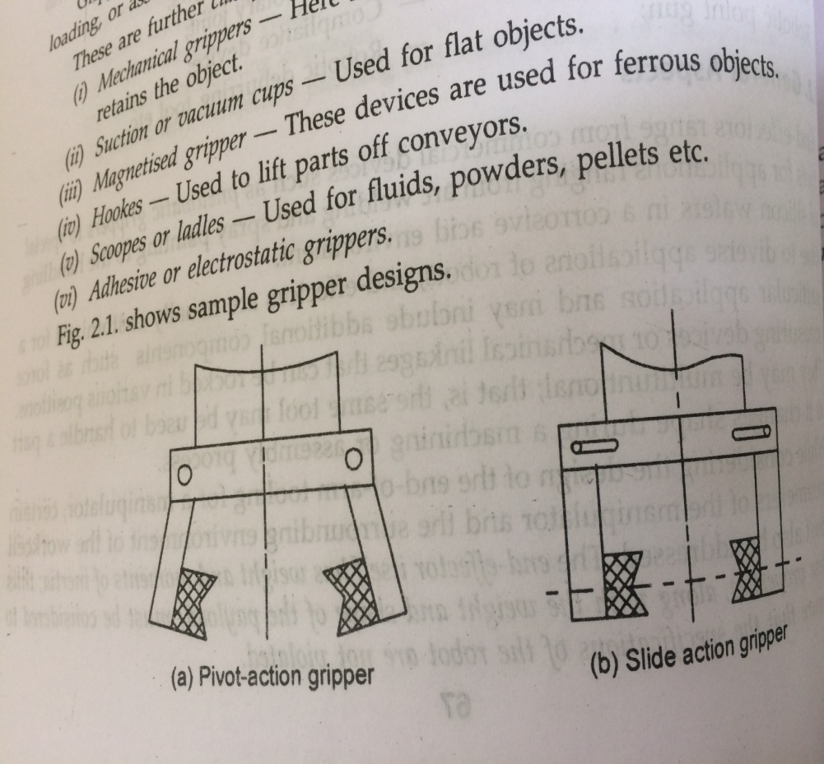
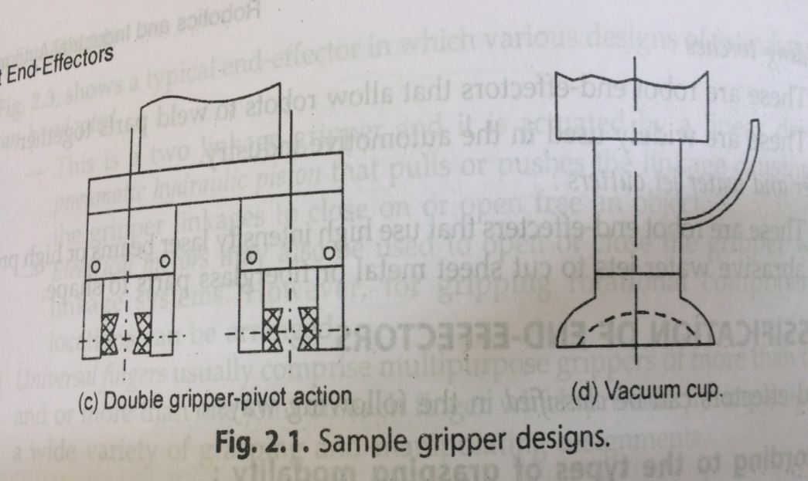
Sample gripper designs
Pivot action gripper
Slide action gripper
Double gripper pivot action
Vaccum cup

Slide 5
Part handling grippers
Used to grasp and hold obj that require to transport from one point to another.
Machine loading & unloading
Picking parts from a conveyor and moving parts etc.
Tool handling grippers
Hold tools like welding gun or spray painting gun to perform specific task.
May hold deburring tool
Specialized grippers
Special like- remote center compliance (RCC)
To insert an external mating component into an internal member, inserting a plug into hole
https://www.youtube.com/watch?v=qFTUFHGGZIg

Slide 6
Tools
Machine tools
Drills
Cutting wheels
Grinding Wheels
Sanders
Measuring instruments

Slide 7
Classification of end effectors
According to the types of grasping modality
Mechanical fingers
Special tools
Universal Fingers
Acc to number of grippers mounted on the wrist
Single Grippers mounted on wrist
Multiple Grippers m o wr

Slide 8
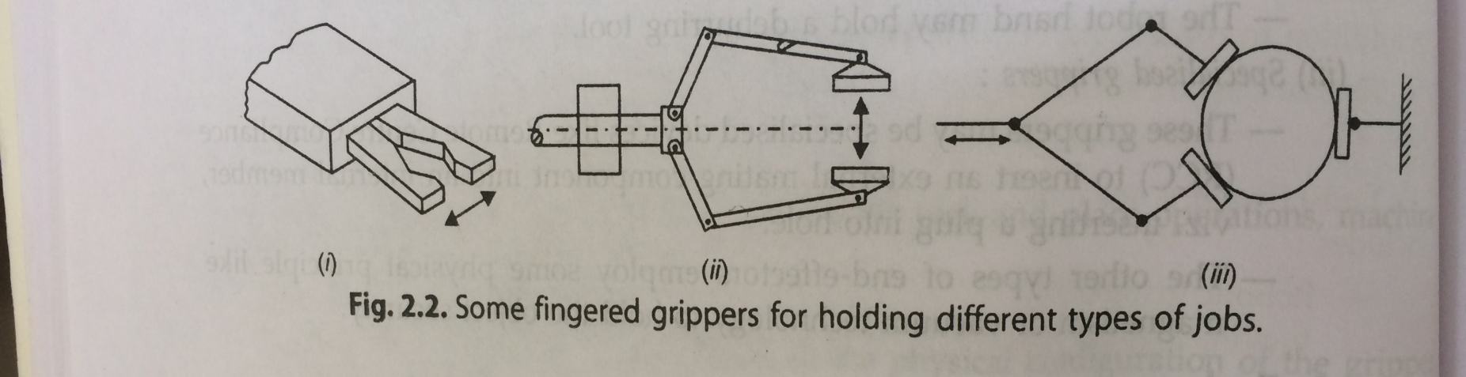
Mechanical Fingers
They are categorized acc to the number of fingers typically TWO,THREE, FIVE. Out of which two fingers are most popular.
Gripping by mechanical type fingers is less versatile and less dextrous than holding by universal fingers as the grippers with mechanical fingers have fewer number of joints and lesser flexibility. However, they economies the device cost.

Slide 9

This is a two linkage gripper and it is actuated by a linear drive system-a Pneumatic hydraulic piston that pulls or pushes the linkage causing rotation of the gripper linkages to close on or open free an object

Slide 10
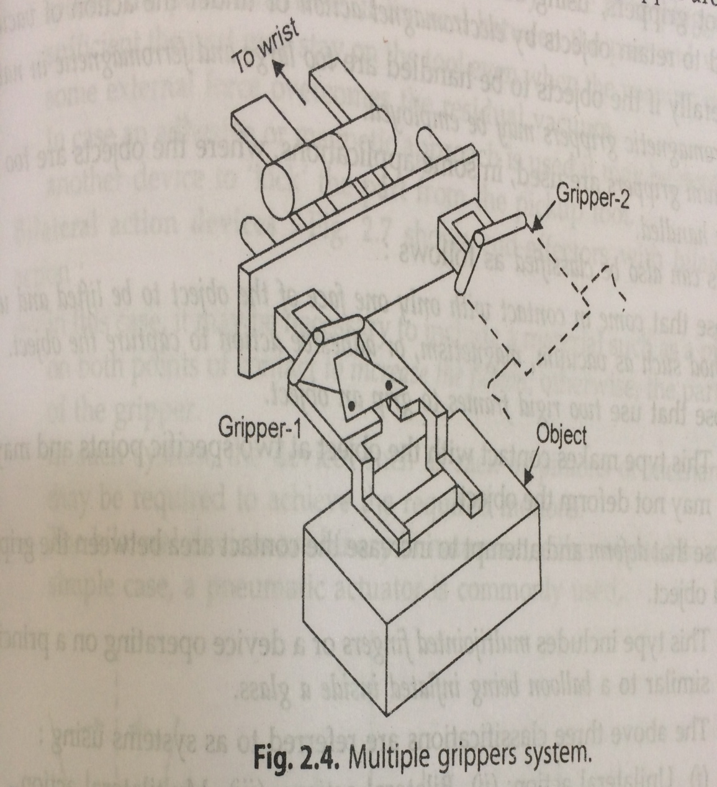
Acc to number of grippers mounted on the wrist
In this system design
Methods for each
Individual gripper are
Subject to those of
Single grippers.

Slide 11
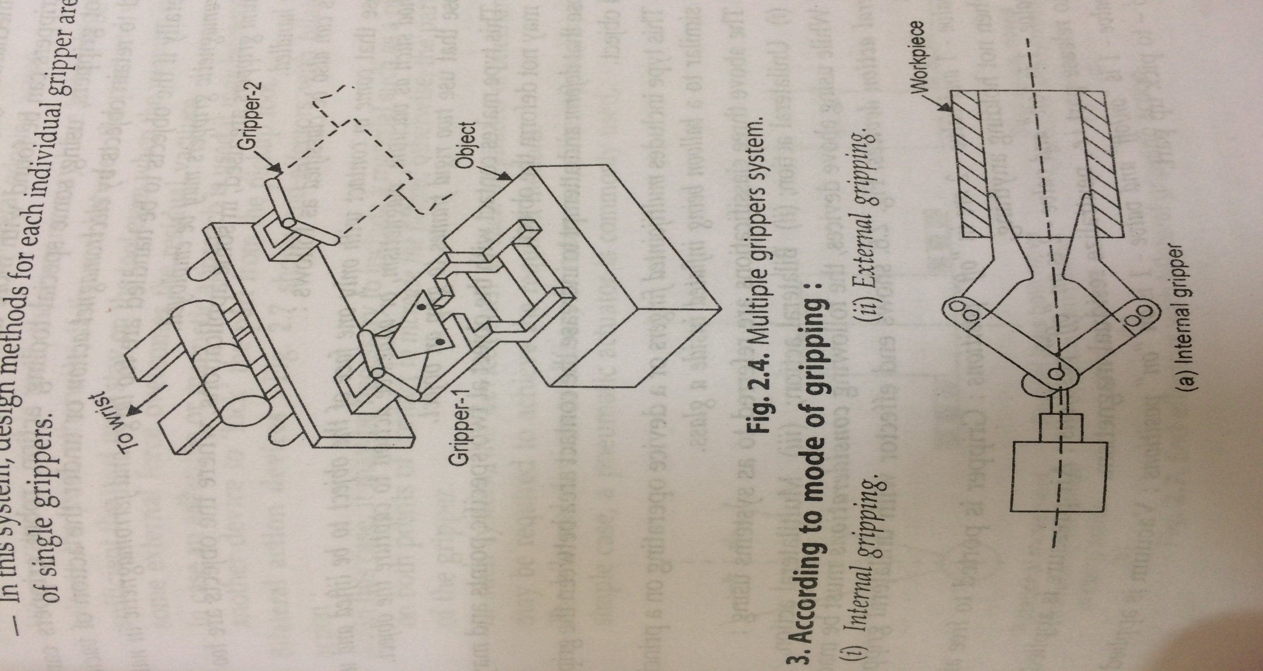
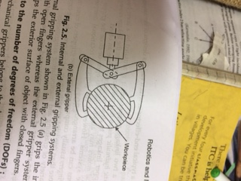
Acc to mode of gripping
Internal Gripping
External Gripping

Slide 12
Acc to the number of DOF
Mechanical grippers belongs to 1 DOF
Few grippers found with more than 2 DOF
Unilateral action devices
Bilateral action devices
Multilateral action devices

Slide 13
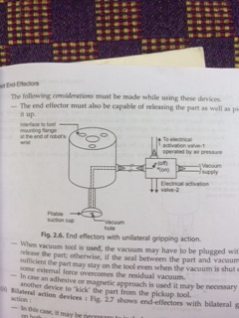
unilateral

Slide 14
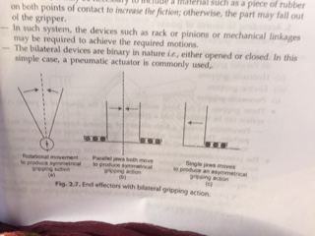
Bilateral

Slide 15
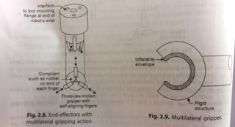
Multilateral

Slide 16
According to the power sources
Pneumatic grippers
(a) Angular gripper
(b) Parallel gripper
Hydraulic grippers
Electric grippers

Slide 17
Pneumatic grippers
Don’t have motors or gears
Power of piston cylinder system use for gripping
Used for small and light package
Used where space is the issue, and low cost
Jaws can be actuated directly by the piston

Slide 18
Angular and parallel grippers
Difference between the two is how there jaws move.
Angular jaws of gripper swing open and closed on pivot
Parallel jaws of gripper slide open and closed in tracks
There can be two or three jaws in either style.

Slide 19
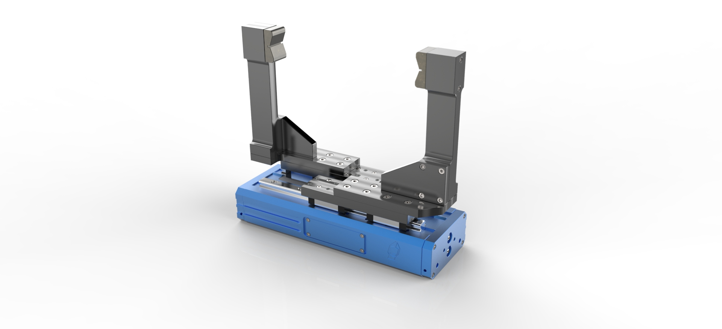
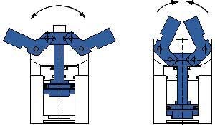
Angular grippers
Parallel grippers
Less costly
Save time when picking parts off a conveyor
Cannot handle wide range of part size
Don’t resist side loads as well.
More costly
Slow in processing
Can handle large sized parts
Can resist

Slide 20
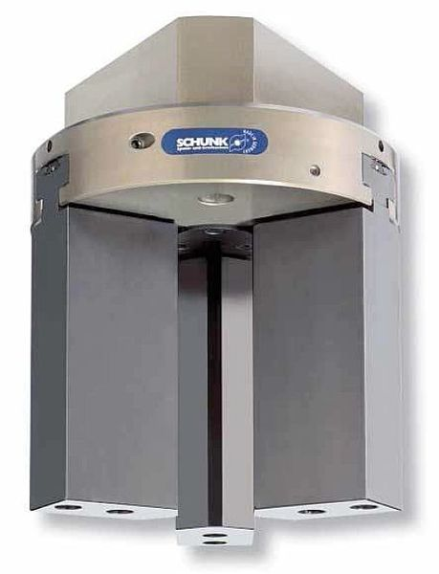
Hydraulic grippers
Provide better gripping power
More costly
Less accurate than pneumatic and electrical grippers
They are messy and much more costly to maintain
Not suitable for clean room applications

Slide 21
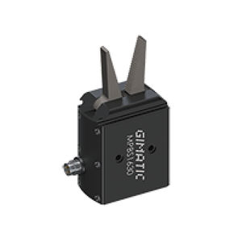
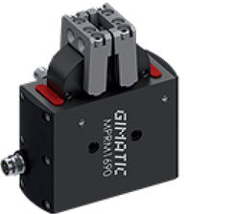
Electric grippers
Use for high speed requirement
Gives light and moderate grip
Don’t create mess and don’t put any dirt
Better control
It size is big
Provide less force than pneumatic

Slide 22
Mechanical Grippers
Use mechanical fingers actuated by mechanism to grasp an object.
It can have interchangeable fingers but two fingers are enough to grip workpiece
-- Mechanical grippers with two fingers
-- Mechanical grippers with Three fingers

Slide 23
Mechanical grippers with two fingers
Most popular gripper in industries
Can be designed for limited shapes of object, especially for cylindrical work piece.
If actuators that produce linear movement are used, like pneumatic piston cylinders the device contains a pair of slider-crank mechanisms.
(a) Pivoting or swinging gripper mechanism
(b) Translational gripper mechanisms

Slide 24
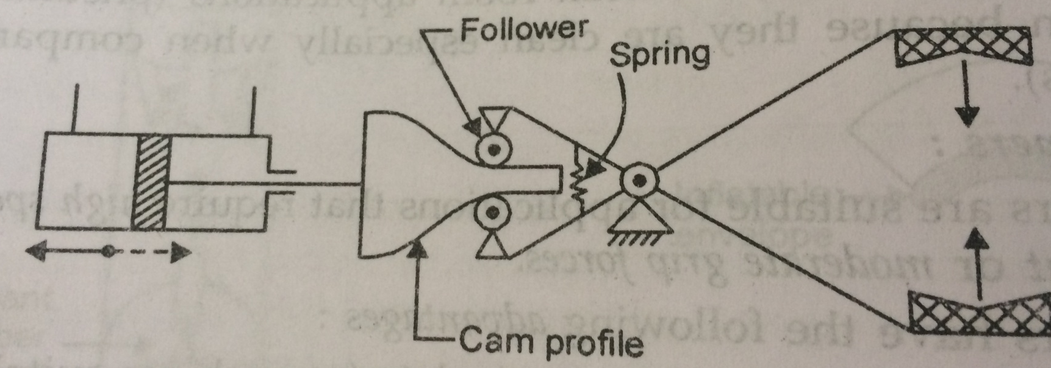
Pivoting or swinging gripper mechanism
Using slider crank mechanism
Using swing block mechanism
Using rotary actuator
Spring helps holding objects of different sizes

Slide 25
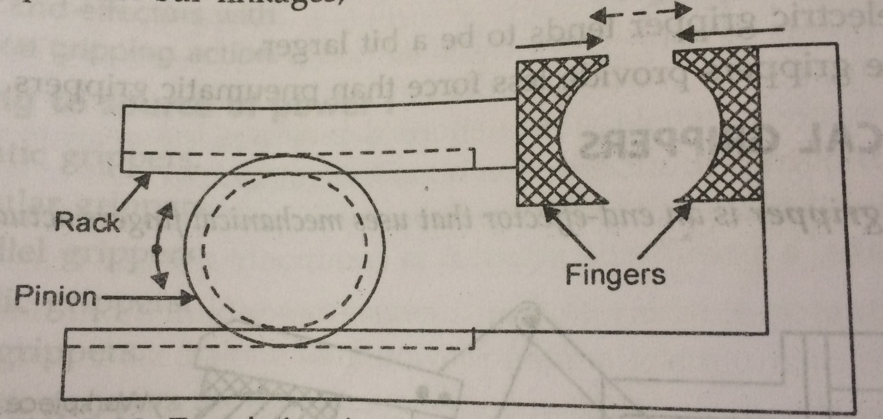
Translational gripper mechanisms
Using screw
Using cylinder piston
Using piston bar linkages
Using Rotary actuators

Slide 26
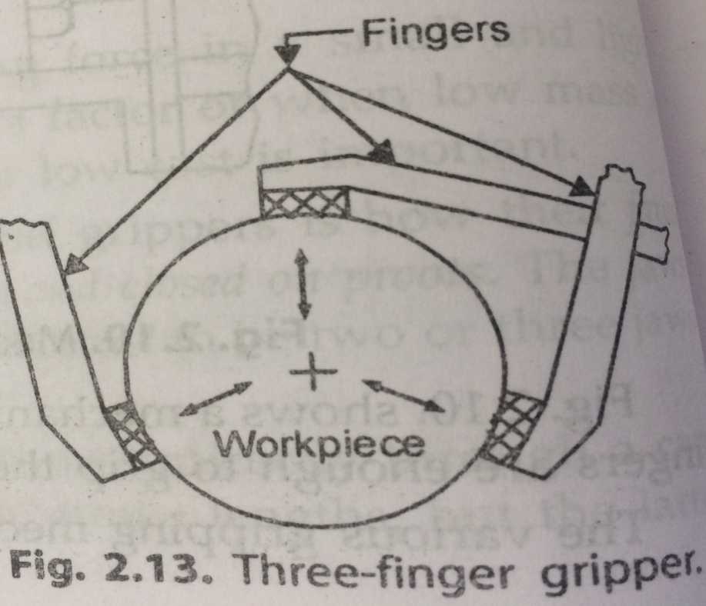
Mechanical grippers with Three fingers
Versatility increased by increasing number of fingers
Reason of adding one more finger is to:
Increase the capability of grasping the objects in
Three spots, enable tight grip for spherical objects
Use ball screw mechanism

Slide 27
Vacuum gripper
It is difficult to grasp large flat objects.
Vacuum gripper helps in it.
Also called “suction grippers”, they use a vacuum pump to generate vacuum between a suction cup and the gripping plane.
Suction cups are made of rubber like material (silicon or neoprene).
Acc. To the design and size of object suction cups get designed.
They are use upto 200 degree celcius.
Number of gripper determine the size and weight of object to be grasped.
For handling soft materials cups made of harder material are used.
Use to grasp- metal plates, pans of glass, or large light weight boxes.

Slide 28
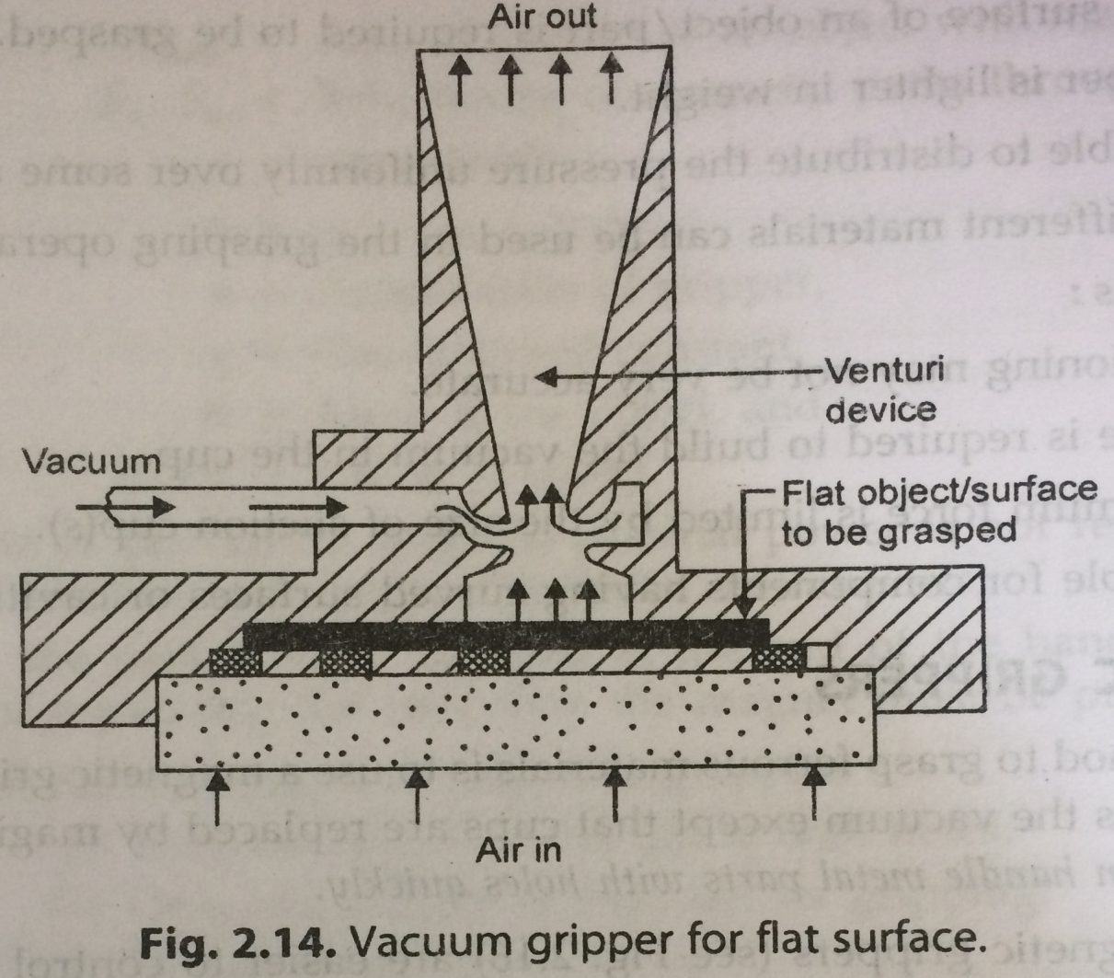


Slide 29
Formula

Slide 30

Vacuum gripper
Advantages
Disadvantages

Slide 31
Magnetic gripper
Simple method to grasp ferrous materials
Principle used is same as the vacuum except that cups are replaced by magnetic grippers.
Easy to control but needs electric power.
Permanent magnets has some disadvantage while releasing the object.
It is small in size and has enormous holding power
Light weight design reduces wear on automatic equipment

Slide 32
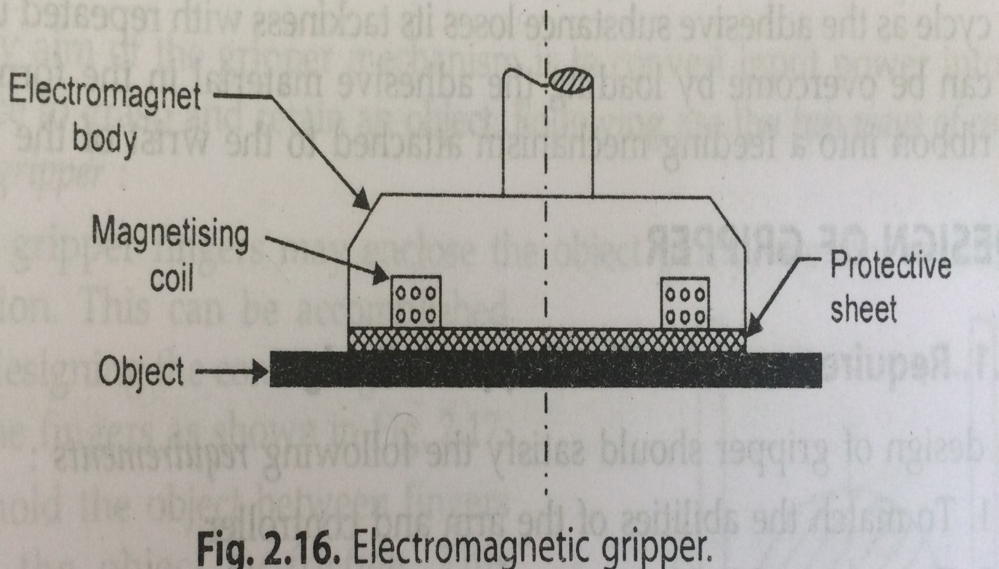

Slide 33
Formula

Slide 34
Magnetic gripper
Advantages
Disadvantages
They can handle metal parts with holes.
Only one surface is require for gripping
Pickup times are faster
Various in part size can be tolerated.
Residual magnetism remaining in the workpiece may cause problems.
While picking up a sheet from the stock, it is possible that more than a single sheet is lifted

Slide 35

Adhesive Grippers
Adhesive substance can be used for grasping action.
Item to be handled must be on one side only.
Reliability of an adhesive is dimished with each successive operation cycle as the adhesive substance loses its tackiness with repeated use.
So to overcome from this problem?

Slide 36
Design of Gripper
Requirement for the gripper design
Tips of Designing a gripper
Force analysis of grippers mechanism

Slide 37
Requirement for the gripper design
Design should satisfy following requirements
To match the abilities of the arm and controller
To grasp and hold the object securely
To complete task

Slide 38
Tips for Designing a gripper
Gripper with passive finger
Gripper with active feedback

Slide 39
Gripper with passive finger
Choose acc to the task to be performed and the geometry and characteristics of parts to be grasped.
Consider the local environments, working space, conveyor positions etc.
Determine the no. of joint links and there config. By part geometry and task movements
Decide the material of construction based on type of duty, corrosion resistance or heat geometry and task movements.
Decide material of construction based type of duty, heat etc.
Select proper actuators--- hydraulic for high forces, electric motors for best control
Pneumatic for less cost and ease etc.

Slide 40
Gripper with active feedback
Use sensor based robots to handle heavy parts.
Use active wrist with passive fingers to handle forces greater than 1 to 2-5 kg

Slide 41
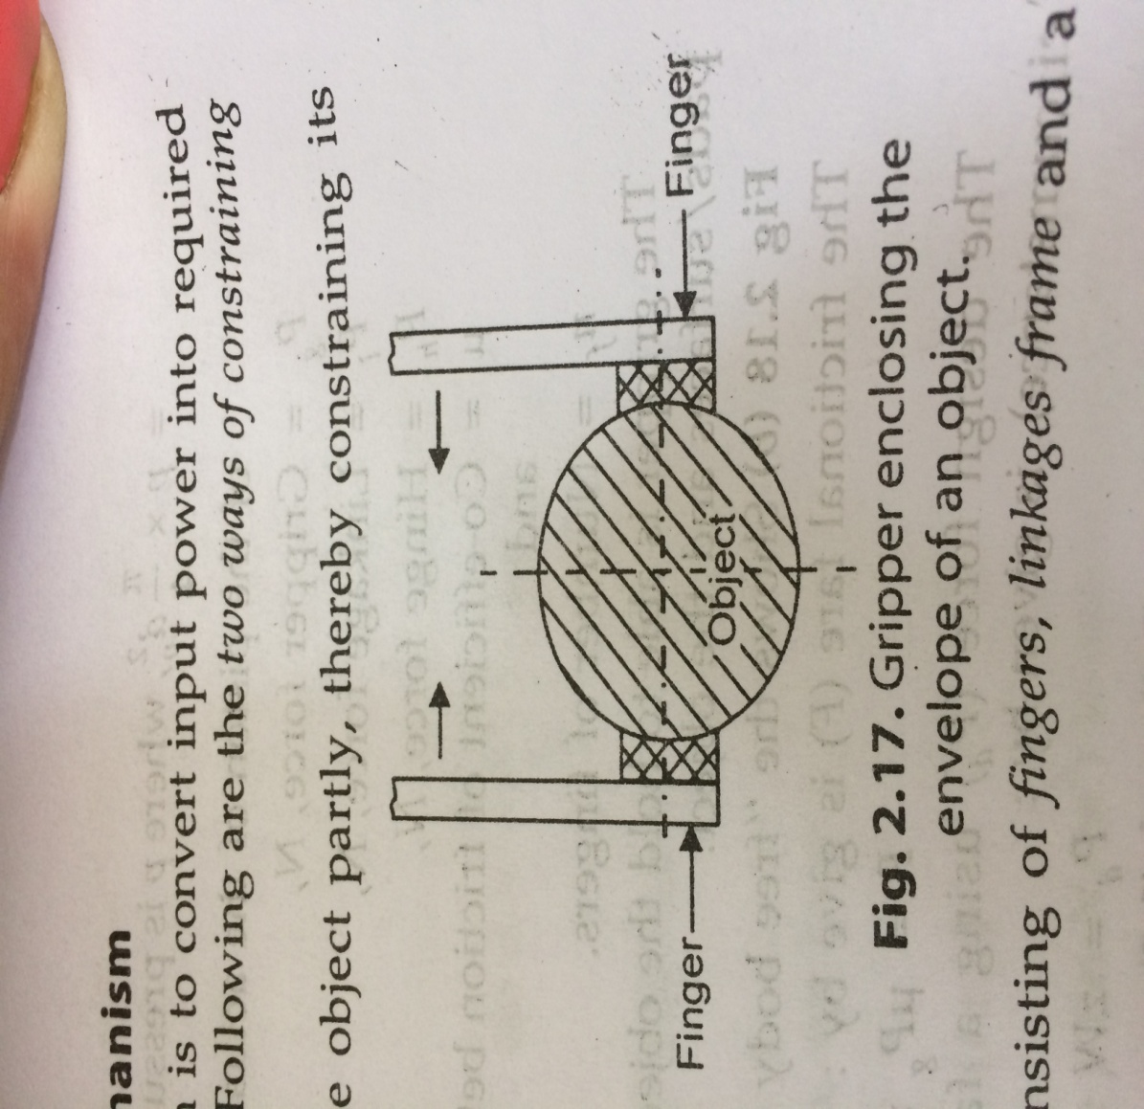
Force Analysis of gripper mechanism
Primary aim of the gripper mechanism is to convert input power into required motion and force to grasp and retain an object.
The gripper fingers may enclose the object partly, thereby constraining its motion. This can be accomplished by designing the contacting surfaces.
To hole the object between fingers and the object by friction. This approach demands that the fingers must apply a force that must be adequate to retain the object against gravity, accelaration and any other force that might arise during holding operation.

Slide 42
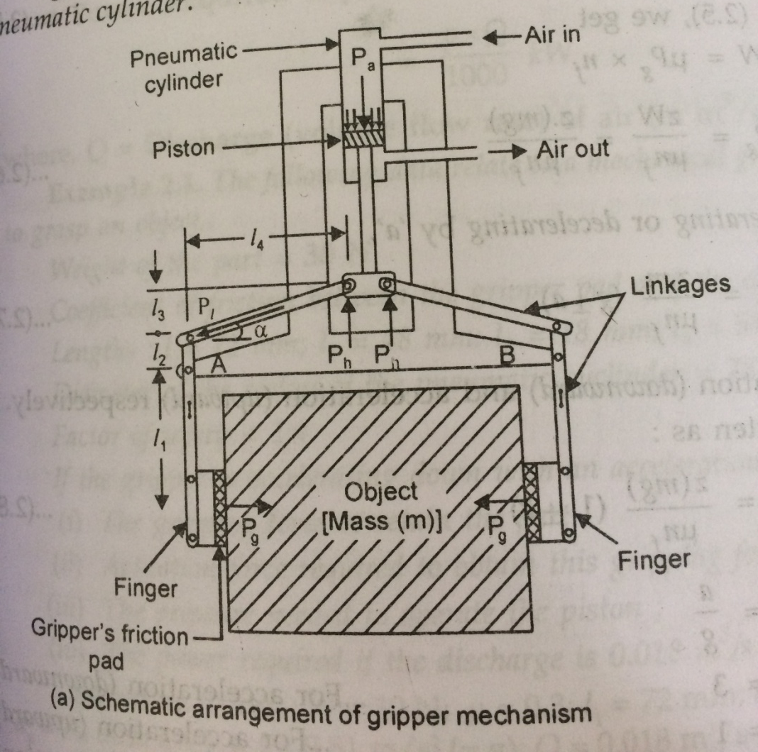
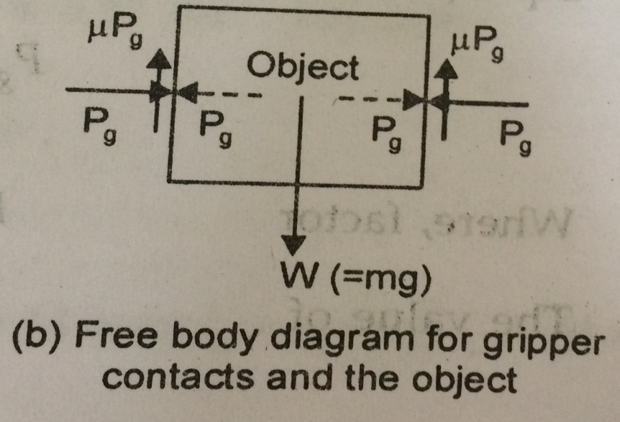
Below fig. shows a gripper mechanism consisting of fingers, linkages frame and a pneumatic cylinder.

Slide 44
Remote center compliance devices (RCC)

