Slide 1
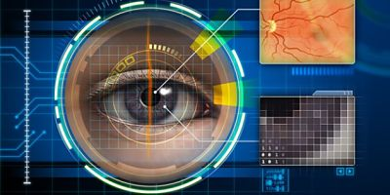
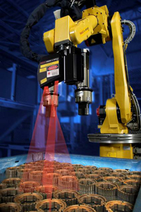

Robotics Sensors and Vision
Presented By: Rashmi

Slide 2
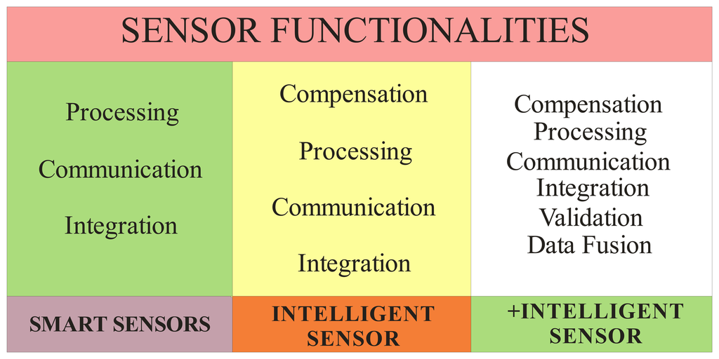
What do you mean by sensor?
Intelligent sensor
Decision making?
Intelligent sensing
environment sensing?

Slide 3
To provide data
Inspection
Quality control
Safety monitoring
To detect and to resolve interlocks in the workcell

Slide 4
Characteristics of sensing device
Range
Response
Accuracy
Sensitivity
Linearity
Environment
Ease of operation
Immune to noise

Slide 5
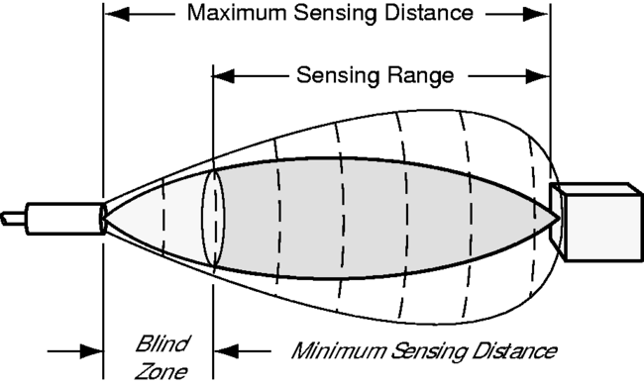
Range
Min to max change in input signal to which the sensor can respond
What we want?
Wide operating range

Slide 6
Response
Should be capable of responding to changes in the sensed variable in minimum time.
Ideally, it is instantaneous.

Slide 7
Accuracy
It should be high as possible

Slide 8
Sensitivity
Change in output with change in input
It should be high as possible

Slide 9
Linearity
The sensory device should exhibit the same sensitivity over its entire operating range.

Slide 10
Types of sensor
Internal state sensors
External state sensors
Potentiometers
Synchros
Resolvers
Linear inductive scales
Differential transformers
Optical encoders
Accelerometers
Tachometers
Optical interrupters
Strain gauges
Pressure transducers
Ultrasonic sensors
Proximity devices
Electromagnetic sensors

Slide 11
Internal state sensors
External state sensors
Use to measure position, velocity, acceleration of robot joints and or the end effector.
Use to monitor the robot’s geometric or relation with task, environment or object that it is handling

Slide 12
Tactile sensors
Non-tactile sensors
Micro switches
Piezoelectric crystals
Potentiometers
Electric strain gauges
Linear voltage differential transformer
Resolvers
encoders
Proximity sensors
Range imaging sensors
Ultrasonic sensors
Electro-optical vision sensors
Magnetic sensors

Slide 13
Status sensors
Environment sensor
Potentiometer
Tachometer
Optical encoder
Micro switch
Contact sensor
pressure, force, slip, torque, surface finish, temperature, pH etc
Non-contact sensor
visional, optical, acoustic, infrared, proximity, range, temperature, chemical etc.
Notes:
Status sensors- to detect position, velocity, acceleration, torque, force etc.
Environment sensors- to detect presence, motion, force, torque etc

Slide 14
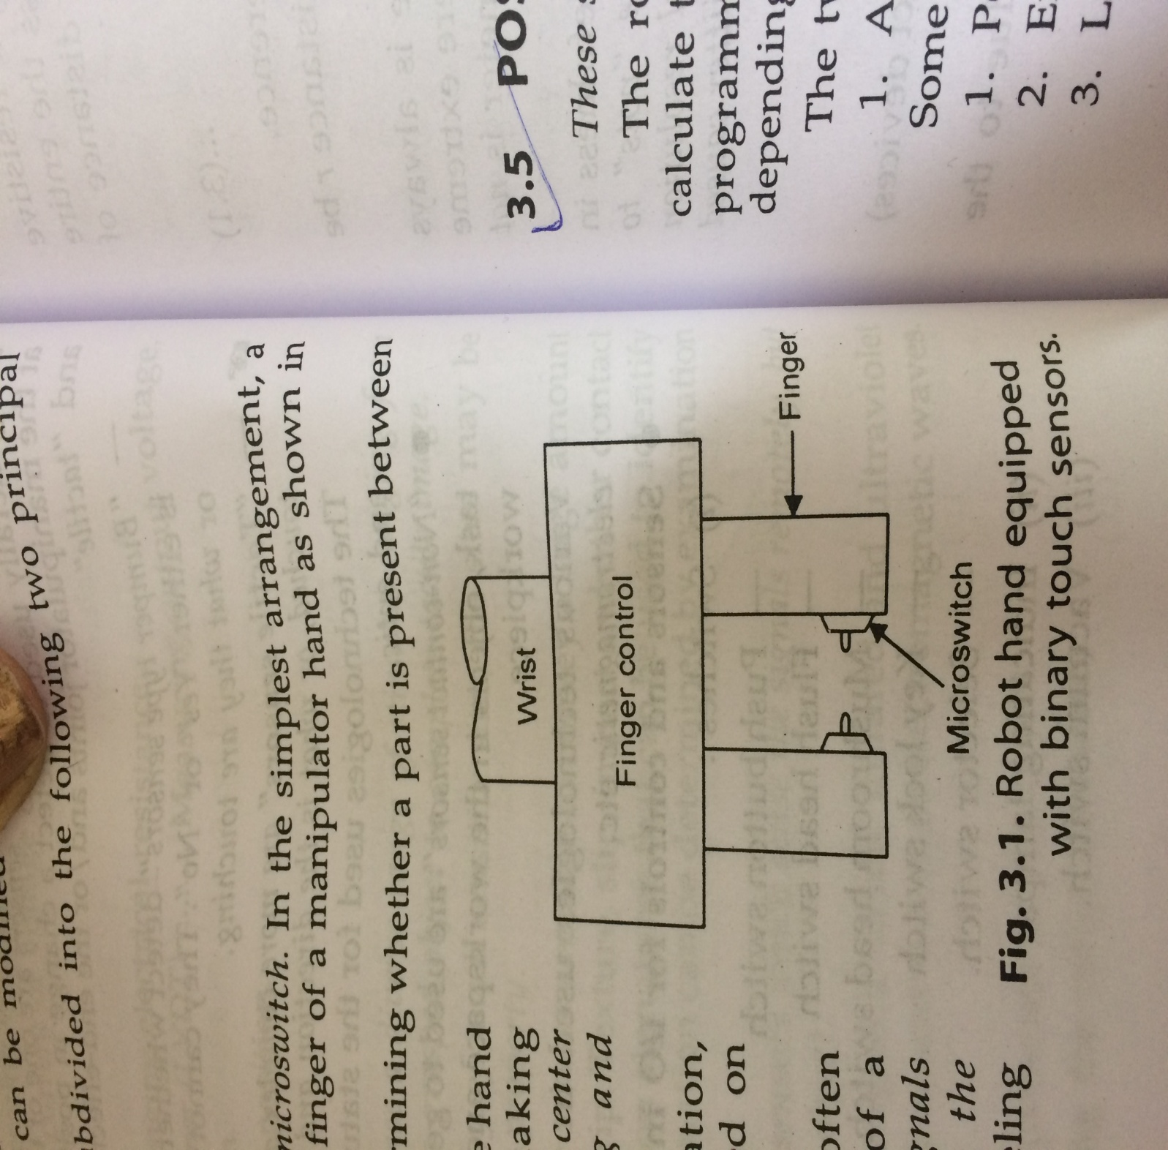
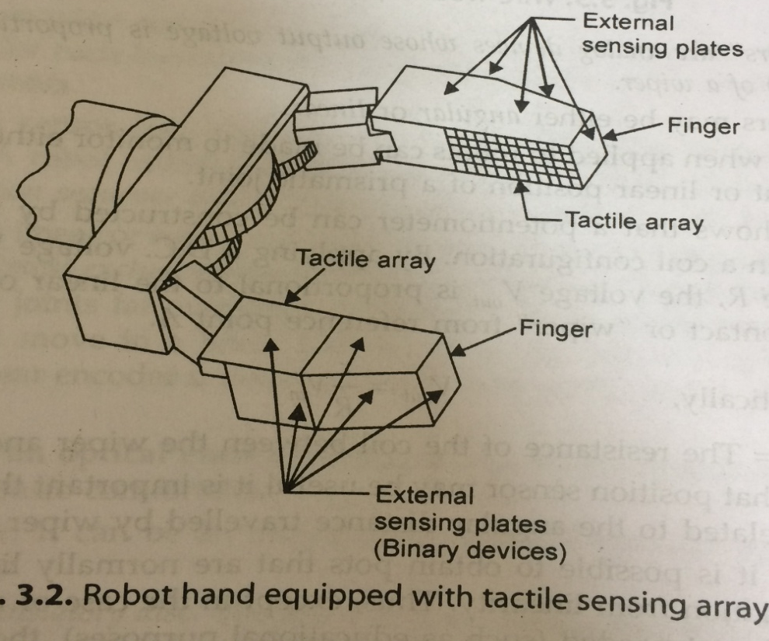
Touch or tactile sensors
Binary sensors
Analog sensors

Slide 15
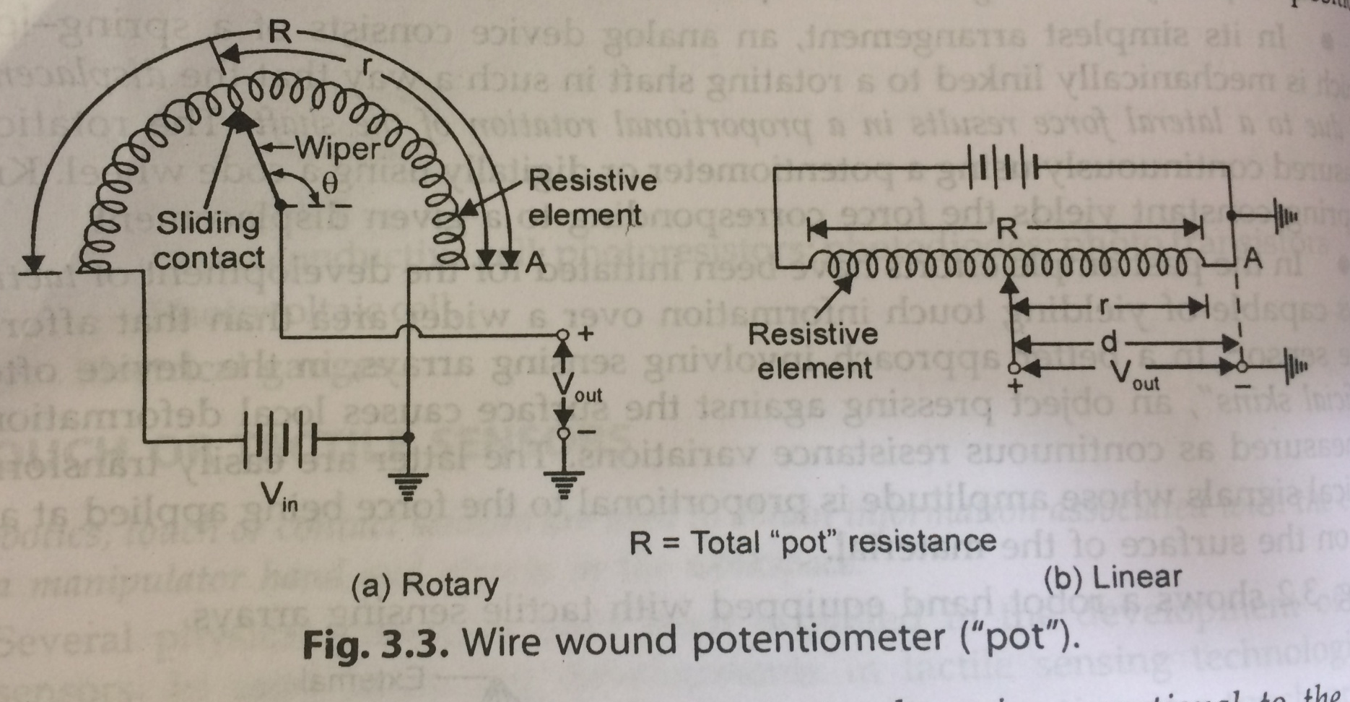
Position and Displacement sensors
Formula

Slide 16
