Slide 1
OPTICAL FIBRES

Slide 2
REFRACTIVE INDEX
Index of refraction of material : ratio of speed of light in vacuum to speed of light in medium
n= c/v
C= speed of light in vacuum
V= speed of light in medium
Higher refractive index means medium is more dense.

Slide 3
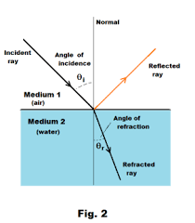
REFRACTION
Bending of light as it travels from one media to another.

Slide 4
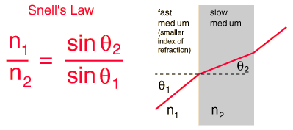
Snell’s Law
Critical angle: Angle of incidence at which angle of refraction = 90⁰

Slide 5
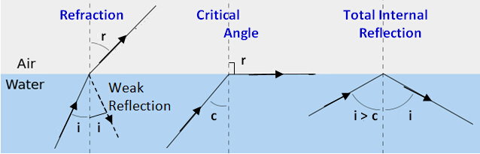
TOTAL INTERNAL REFLECTION
When angle of incidence is made greater than critical angle, the light ray is reflected back into the same medium. This phenomenon is called TIR.

Slide 6
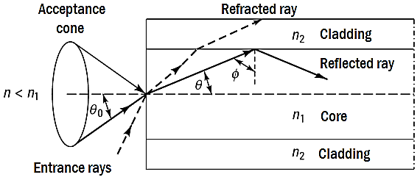
ACCEPTANCE CONE

Slide 7
Acceptance angle is defined as that maximum angle of light with the axis beyond which the light cannot be propagated by total internal reflection.
If all the acceptance angles are considered at the entry then there exists a three dimensional cone which is known as Acceptance cone.

Slide 8
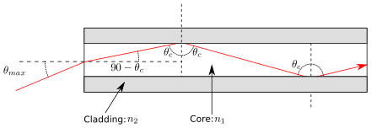
NUMERICAL APERTURE
Numerical aperture is considered as a light gathering capacity of an optical fibre.

Slide 10
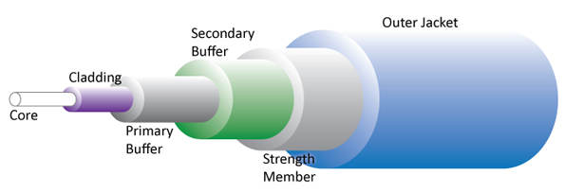
STRUCTURE OF OPTICAL FIBRE

